Slide 1
SECONDARY BATTERIES

Slide 2
INTRODUCTION
Rechargeable batteries (also known as secondary cells) are batteries that potentially consist of reversible cell reactions that allow them to recharge, or regain their cell potential, through the work done by passing currents of electricity.

Slide 3
working
Rechargeable (or secondary) batteries contain active materials that can be regenerated by charging. All batteries have positive and negative terminals, marked (+) and (-) respectively, and two corresponding electrodes. The electrodes must not touch each other, and are separated by the electrolyte, which facilitates the flow of electric charge between the electrodes. A collector conducts the charge to the battery's exterior and through the load.

Slide 4
When a battery is inserted into an electrical device, the device completes the circuit between the two terminals and triggers electrochemical reactions within the battery. The anode undergoes an oxidation reaction with the electrolyte and releases electrons, while the cathode undergoes a reduction reaction and absorbs the free electrons. The product of these two reactions is electricity, which is channeled out of the battery and into the device.

Slide 5
When a secondary battery is recharged, its electrodes undergo an opposite process to the discharging action described above. As the battery charger passes electricity through the battery, its cathode is oxidized and produces electrons which are then absorbed by the anode. When the battery is fully charged, it can be connected to a load and discharged again.

Slide 6
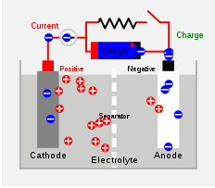
Working(charging)

Slide 7
lead–acid battery
nickel–cadimium battery
Types Of Secondary Batteries
lithium-ion battery

Slide 8
1.Lead acid Batteries

Slide 9
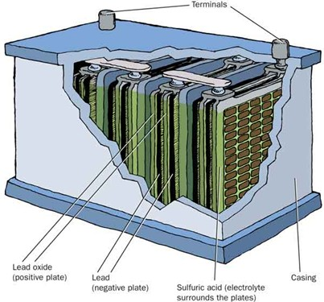
1 Chemistry of a Lead Acid Battery
2 Composition of a Lead Acid Battery
Positive Plate: Lead Oxide (PbO)
Negative Plate: Lead (Pb)
Electrolyte: sulphuric acid (H2SO4)
3 Review of Acid Terminology
Strong vs. Weak Acids
Strong acids completely ionize in water
EX: HCl → H+ + Cl- (HCl + H2O → H3O+ + Cl-)
Weak acids partially ionize in water
EX: HC2H3O2 ⇌ H+ + C2H3O2-
(note ⇌ versus ) Monoprotic vs. Diprotic Acids
Monoprotic acid has one H+ (EX: HCl)
Diprotic acid has two H+ (EX: H2SO4)

Slide 10
4 The Electrolyte: H2SO4
H2SO4 is classified as a strong acid (completely ionizes) but that is not exactly true. The first ionization of H2SO4 is complete and occurs instantly when in water.
EX: H2SO4 → H+ + HSO4-
But! The second ionization is extremely partial.
EX: HSO4- ⇌ H+ + SO4-2 (Ka = 0.012!)
This is very important in understanding the chemistry of a lead acid battery!
5 for understanding
In general, is sulfuric acid considered a strong or weak acid?
Strong- Why is sulfuric acid considered to be strong?
It completely ionizes
What ion related to sulfuric acid is weak?
HSO4̶- Why is the bisulfate ion, HSO4̶ considered weak?
It partially ionizes

Slide 11
6 Lead Acid Batteries are rechargable
This leads to two different sets of redox reactions.
The discharging phase. The charging phase.
7 Chemistry of Discharge Phase
Negative plate reaction (oxidation):
Pb + HSO4̶ → PbSO4 + H e̶
Positive plate reaction (reduction):
PbO2 + HSO4̶ + 3H+ + 2e- → PbSO4 + 2H2O
Overall discharge redox reaction:
Pb + PbO2 + 2 HSO4̶ + 2H+ → 2 PbSO4 + 2H2O
or…Pb + PbO2 + 2 H2SO4 → 2 PbSO4 + 2H2O
Note: states are removed for simplicity
Pb, PbO2, and PbSO4 are always solids
HSO4-, H+, and H2SO4 are always aqueous
H2O is always a liquid

Slide 12
8 The flow of electrons = ELECTRICITY!
9 Chemistry of Charge Phase
Negative plate reaction (reduction):
PbSO4 + H e- → Pb + HSO4̶
Positive plate reaction (oxidation):
PbSO4 + 2H2O → PbO2 + HSO4̶ H+ + 2e-
Overall charge redox reaction:
2 PbSO4 + 2H2O → Pb + PbO2 + 2 HSO4̶ + 2H+
or…2 PbSO4 + 2H2O → Pb + PbO2 + 2 H2SO4
10 for understanding
What metal is always at the negative plate? Pb
What compound is always at the positive plate? PbO2
What is the electrolyte in a battery? H2SO4 or HSO4̶
What compound is the “waste” product of discharge and has to be removed in the charging process? (think!) PbSO4

Slide 13
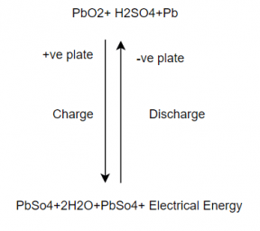
The combined equation for both the processes is represented as
11 Why do batteries “die”?
Dead Battery
New Battery
When the battery discharges solid PbSO4 is formed.
In a new battery, the PbSO4 is in a spongy form which can easily be converted back to Pb and PbO2.
Over time the PbSO4 will tend to crystallize.
The crystallized PbSO4 cannot be converted back to Pb and PbO2 so there is not only less reactant material but it also coats the surface of the Pb and PbO2.
New Battery
Dead Battery

Slide 14
Life
The optimum functional temperature for lead acid battery is 25⁰C which means 77⁰F. The increase in the range of temperature shortens longevity. A per the rule, for every 80oC increase in temperature, it reduces the half-life of the battery. While a value regulated battery that functions at 25⁰C has a lead acid battery life of 10 years. And when this is operated at 33⁰C, it has a life period of 5 years only.
Lead Acid Battery Applications
These are employed in emergency lightening to provide power for sump pumps.
Used in electric motors
Submarines
Nuclear submarines

Slide 15
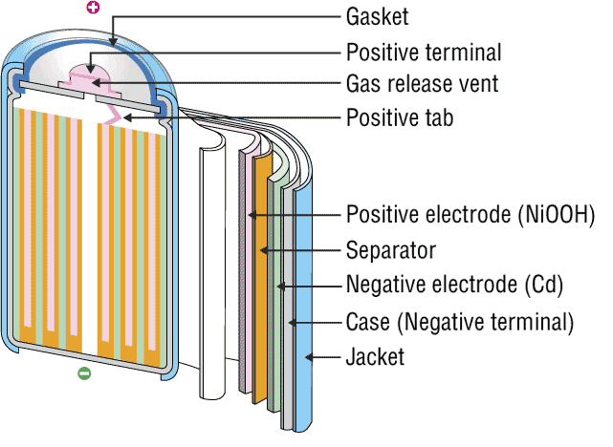
INTRODUCTION
2. NICKEL-CADMIUM BATTERY
The nickel–cadmium battery is a type of rechargeable battery using nickel oxide hydroxide and metallic cadmium as electrodes. Ni-Cd batteries are made in a wide range of sizes and capacities.
Nickel(hydroxide)–cadmium systems are the most common small rechargeable battery type for portable appliances. The sealed cells are equipped with “jelly roll” electrodes, which allow high current to be delivered in an efficient way. These batteries are capable of delivering exceptionally high currents, can be rapidly recharged hundreds of times, and are tolerant of abuse such as over discharging or overcharging.
It produces a voltage of about 1.4 V

Slide 16
INVENTIONS AND SCOPE
Nickel-cadmium (NiCd)
Invented by Waldemar Jungner in 1899. Developments were slow, but in 1932, advancements were made to deposit the active materials inside a porous nickel-plated electrode. Further improvements occurred in 1947 by absorbing the gases generated during charge, which led to the modern sealed NiCd battery.
For many years, NiCd was the preferred battery choice for two-way radios, emergency medical equipment, professional video cameras and power tools. In the late 1980s, the ultra-high capacity NiCd rocked the world with capacities that were up to 60 percent higher than the standard NiCd.
Since the disposal of battery is hazardous to environment alternative cells are being used such as paper battery

Slide 17
RECENT TRENDS
The primary trade-off with Ni–Cd batteries is their higher cost and the use of cadmium. This heavy metal is an environmental hazard, and is highly toxic to all higher forms of batteries.
Recently, nickel–metal hydride and lithium-ionbatteries have become commercially available and cheaper, the former type now rivaling Ni–Cd batteries in cost..
The batteries are more difficult to damage than other batteries, tolerating deep discharge for long periods.
Ni–Cd batteries typically last longer, in terms of number of charge/discharge cycles, than other rechargeable batteries such as lead/acid batteries.
Compared to lead–acid batteries, Ni–Cd batteries have a much higher energy density.
In consumer applications, Ni–Cd batteries compete directly with alkaline batteries. A Ni–Cd cell has a lower capacity than that of an equivalent alkaline cell, and costs more.
The capacity of a Ni–Cd battery is not significantly affected by very high discharge currents.

Slide 18
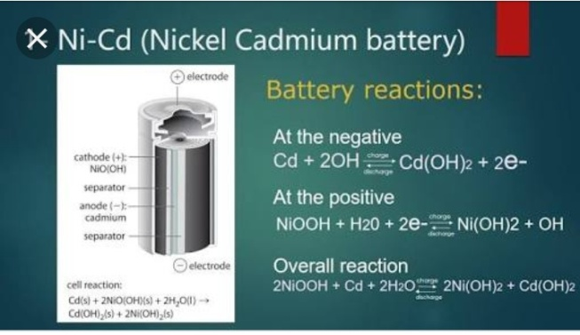
CELL REPRESENTATION AND
CELL REACTION
A typical Ni-Cd battery is represented as
Cd| Cd(OH)2|| NiO(OH)| Ni(OH)2
Cell reaction while discharging
At Anode: oxidation of Cd metal
Cd + 2OH_ Cd(OH)₂ + 2e⁻
At cathode: reduction of NiO(OH)
2NiO(OH) + 2H₂O + 2e⁻ 2Ni(OH)₂ + 2OH⁻
Net Cell reaction:
2NiO(OH) + 2H₂O + Cd 2Ni(OH)₂ + Cd(OH)₂

Slide 19
ADVANTAGES
Fast and simple charging process
It is compact and lighter than traditional batteries
It has a longer life than lead storage batteries
Available in a wide range of sizes and performance options
Good low-temperature performance
Only battery that can be ultra-fast charged with little stress

Slide 20
LIMITATIONS
It is rather more expensive than a lead storage battery
It has a lower energy density value
Cadmium is a toxic metal. Cannot be disposed of in landfills
Memory effect; needs periodic full discharges
High self-discharge; needs recharging after storage

Slide 21

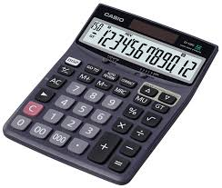
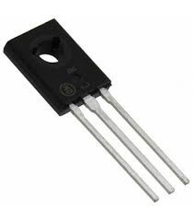

APPLICATIONS
Ni-Cd cells are popularly used in many appliances because they are available in variety of sizes and capaciities.
Few examples are:
Calculators
Electronic flash units
Transistors
Cordless appliances

Slide 22
3. RECHARGEABLE LITHIUM Batteries

Slide 23
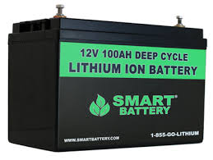
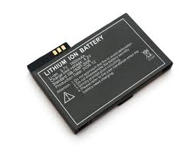
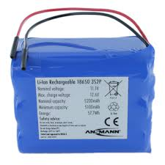
DESCRIPTION
A lithium-ion battery or Li-ion battery (abbreviated as LIB) is a type of rechargeable battery in which lithium ions move from the negative electrode to the positive electrode during discharge and back when charging.
The electrolyte, which allows for ionic movement, and the two electrodes are the constituent components of a lithium-ion battery cell.

Slide 24

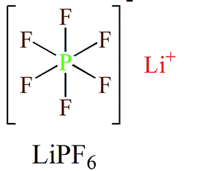
Electrolytes
Role-
Ion conduction between cathode and anode.
They are generally, Lithium salts dissolved in organic solvent.
Commercial electrolytes: in Carbonate solvent.

Slide 25
Anode Materials
Requirements:
Large capabilites of adsorption.
High efficency of charge/discharge.
Low reactivity against electrolyte.
Fast reaction rate.
Low cost
Environment friendly
Commercial anode materials:
Hard Carbon, Graphite

Slide 26
Cathode Materials
Requirements:
A high discharge voltage
A high energy capacity
A high power density
Light weight
Low self discharge
Environment friendly
Commercial cathode materials:
LiCoO2, LiFePO4 etc.

Slide 27
Chemical Reactions
Main essential components...
Anode: Graphite [carbon] - C(s)
Cathode: Lithium Cobalt Oxide - LiCoO2
Electrolyte: Typically a combination of lithium salts - LiPF6, LiBF4, or LiClO4, in an organic solvent, such as either.
Separator: The separator is a very thin sheet of micro perforated plastic. - CH2=CHCl

Slide 28
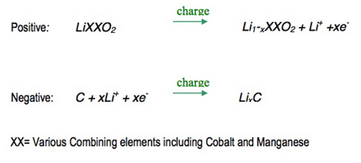
Reactions while charging
On charge the positive electrode, cathode, material is oxidized, Li+ ions are de-intercalated from the layered lithium LiCoO2, pass across the electrolyte and are intercalated between the graphite layers in graphite by an electrochemical reduction reaction proceeding at the negative electrode.

Slide 29
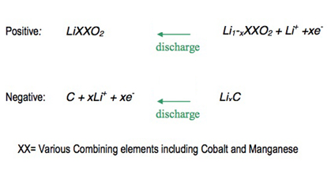
Reactions while discharging
When the cell is discharged, an oxidation reaction occurs at the negative electrode, Li+ ions are de-intercalated from the anode and migrate across the electrolyte to be re-intercalated into the cathode material, due to charge balance the equivalent number of electrons travel through the external circuit. A simultaneous electrochemical reduction reaction proceeds at the positive electrode and accepts electrons from the external circuit, Li+ ions from the electrolyte, to reform the starting material. A change from electronic current to ionic current occurs at the electrode/electrolyte interface.

Slide 30
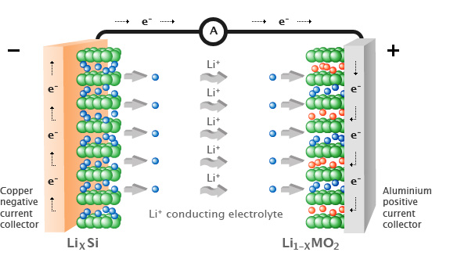
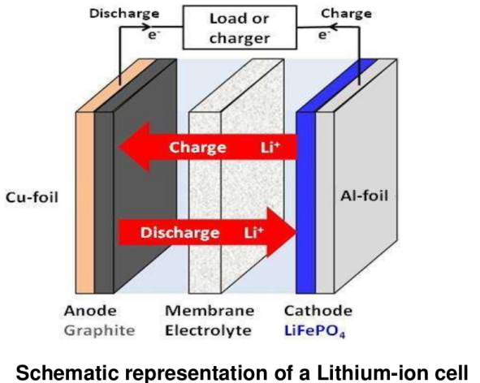


Slide 31
Applications
Emergency Power Backup Or UPS
Dependable Electric And Recreational Vehicle Power
Solar Power Storage
Reliable And Lightweight Marine Performance
Solar Power Storage
Surveillance Or Alarm Systems In Remote Locations
Personal Freedom With Mobility Equipment
Portable Power Packs That Eliminate Downtime

Slide 32
